Slide 1
Product Marketing Reporting
September 9, 2025

Slide 2
SHRM Learning System

Slide 3

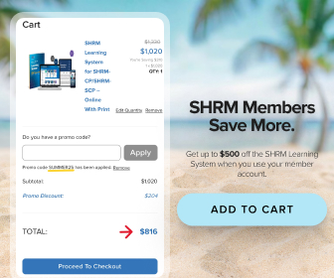
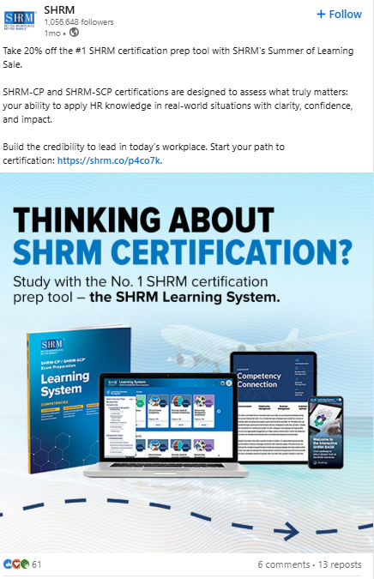

Summer of Learning Campaign (7/29-9/1/25)
Overview of marketing tactics:
Personalized hub page for all things Summer of Learning.
Paid social and programmatic display ads ran for the entire month of August. Organic posts went live around August 1 on LinkedIn and Meta.
Evergreen e-newsletter banners at the bottom of emails and HR Daily email campaigns.
Anteriad Emails (7/30, 8/12, 8/19; 8/26.)
Omnichannel approaches including ads and weekly emails for LS, certification and seminars helped reach more than $1 million in overall revenue.
Tentative Summer of Learning promo code amount: $916,000+ per Adobe Analytics or more than 240 individual uses.
Learning System Self-Study amount: $1,072,378.

Slide 4
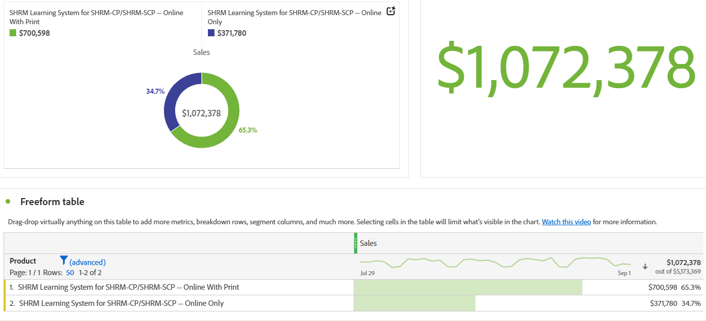
Product Revenue Reporting
More users took advantage of the SUMMER25 promotion and purchased the LS with the textbook versus 34.7% of those that purchased the online only version. Total promo uses: 241+ (still verifying numbers).
(Source: Marketo)

Slide 5
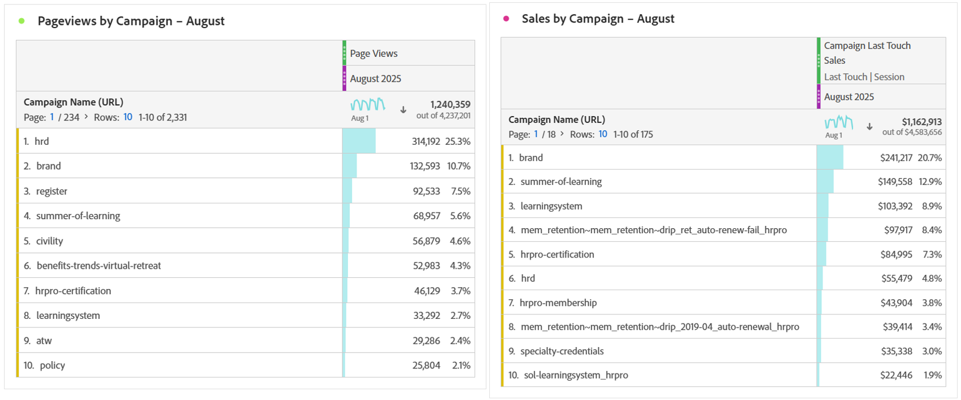
Reporting
Summer of Learning, Certification and Learning System were the highest performing emails and website page views for all of August.
(Source: Marketo)

Slide 6
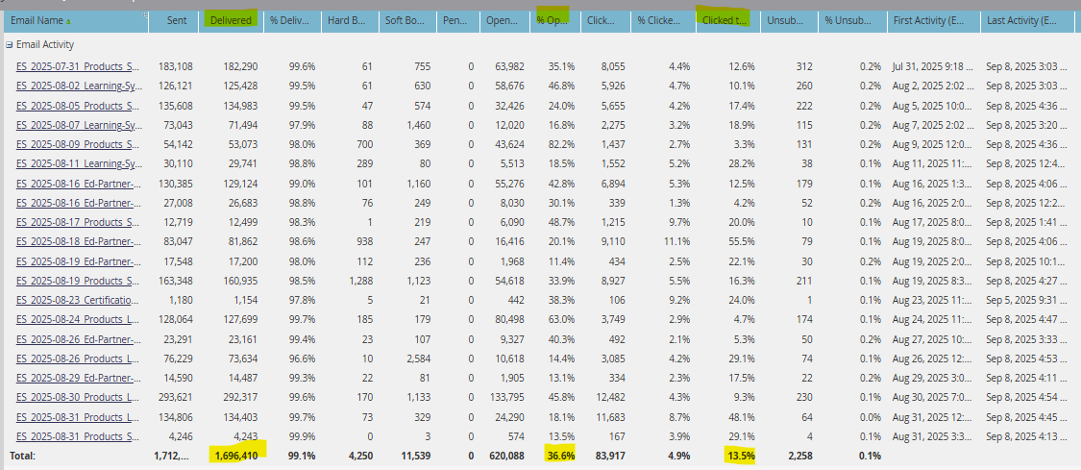
Email Campaign Reporting
Email metrics for SHRM Learning System from 7/31-8/31. (Source: Marketo)
Quick Stats:
20 emails including the Cozy Up to Cert webinar email campaign.
Delivered quantity: 1,696,410
Avg open rate: 36.6%
Click-through rate (CTR): 4.9%
Click-to-open rate (CTOR): 13.5%

Slide 7


Projects in Progress
Upcoming: Week of 9/9/2025
Global partner course website update – should be completed by next week.
Domestic pages also needed to be revised before sending out email campaigns (last emails went out on 8/26 and 8/28).
Create a recurring monthly drip email campaign in Marketo for both domestic and global partners. This avoids hitting the email cap and excludes audience from weekly sends with suppression segmentation.
Continue adding SHRM Seminars and Partners as secondary study options in overall LS emails.
SHRMDay! Last September’s SHRMDay only reached $377,000 in additional LS sales compared to May 2025. Plan is to promote at least 2x via email before the actual day (9/26). Overall campaign goal is $4 million.
Presale Campaign Strategy:
New name (SHRM Certification Prep System) and a short presale campaign will begin around Nov. 16-Dec. 17. This includes weekly emails with new email banner art, removal of any LS mention on the website (including the new videos) and creating new paid ads based on the new look and feel. We will not run paid ads for the presale due to the short window of time, but we will use new ads for a post-presale evergreen campaign.

Slide 8
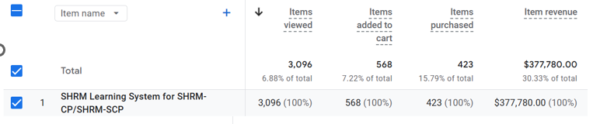
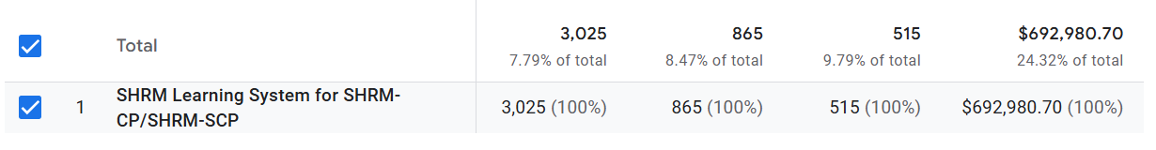

SHRMDay Reporting
Quick Stats:
May 20’s SHRMDay had an 83% increase in revenue compared to Sept. 26’s SHRMDay.
September 2024 vs. May 2025
Source: Google Analytics 4

Slide 9
Questions?
Source: Google Analytics 4

